Slide 1
हल
कृषि के लिए तकनिकी पहल

Slide 2

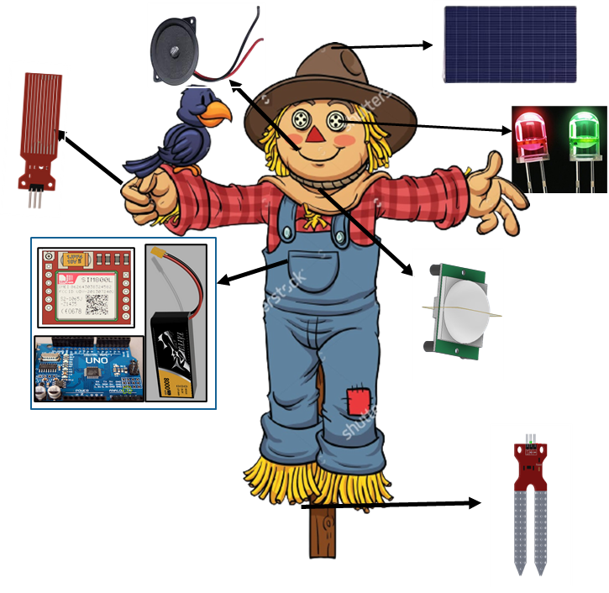

Slide 3
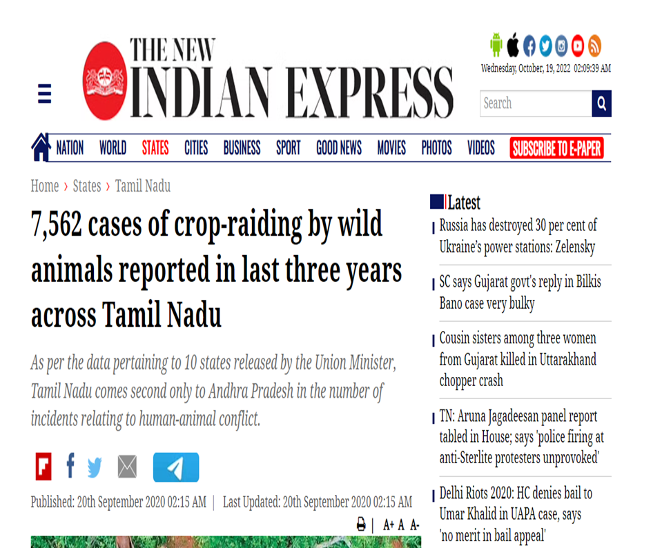
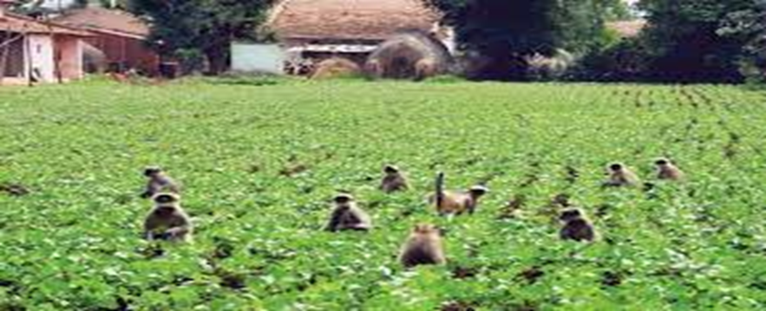
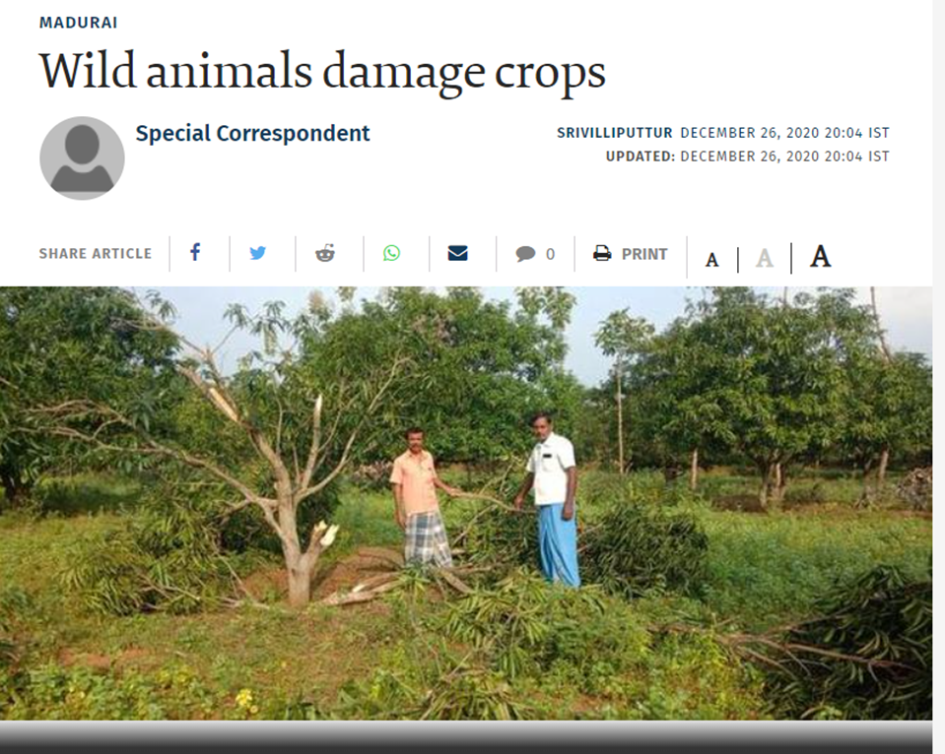
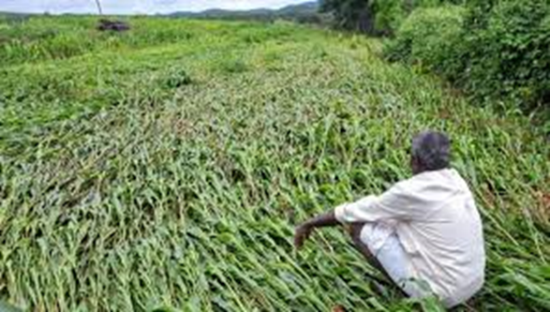

Slide 4
Challenges:
As per the reports published by the government organisations the percentage of damaged are increasing gradually every year.
As of the now there are more than 20% crops were damaged due to the stray animals and birds .
According to THE NEW INDIAN EXPRESS more that 7500 cases were registered in Tamil Nadu in last three years.
According to the government survey crop damage by wild animals declined by 33% which is almost around 1,65,000 tonnes as of the 2020 survey report.
And so to protect their handwork the farmers started to harm and even something kill the stray animals.

Slide 5
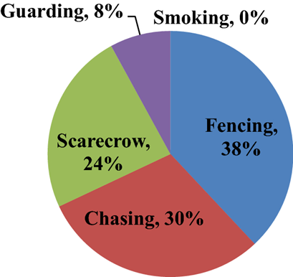
Why choose हल over our traditional methods ?
There are many methods to kept the animals out of the field. Some of the famous methods are given as below:
(1)Using Fencing
(2) Using Repellents and many more
The costing of both these methods are very high.
For example the cost for fencing a one acres of
farm is around 50000/- rupees
(As the cost of one pole is around 500/- and cost of wire is around 6000/- per 100meter)
where as the cost of our project is around 20,000/-rupees.

Slide 6
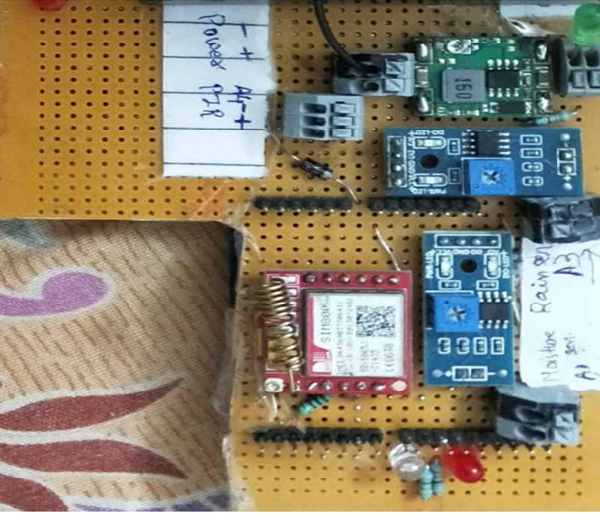
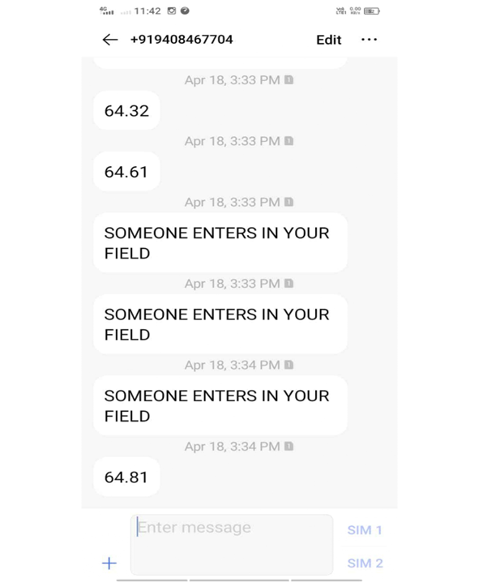

Slide 7
